Slide 1
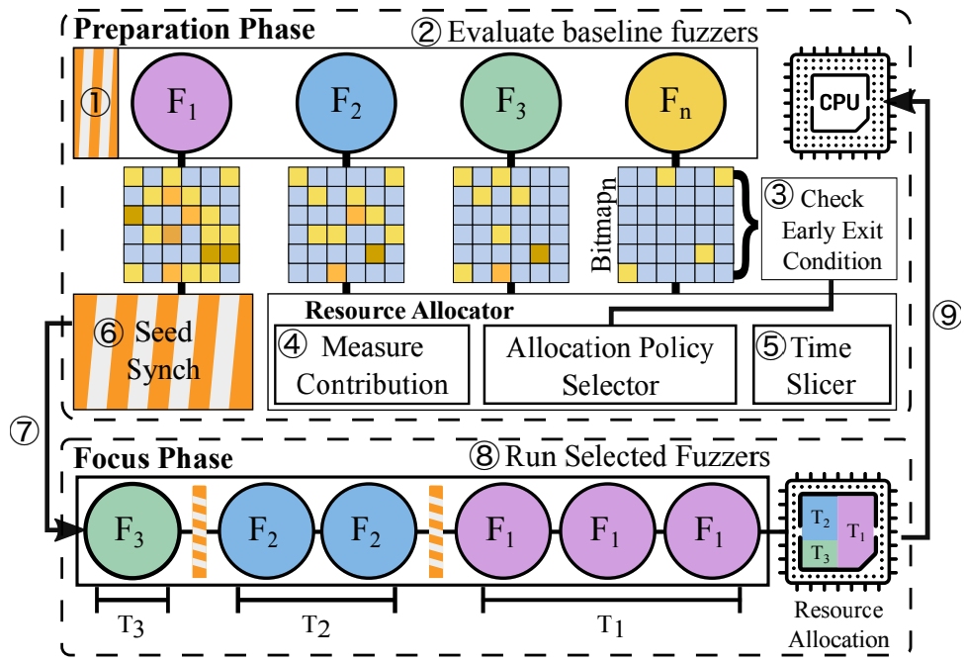

“ARMy Fuzzing”: Mid-Term Update
Kate Smith, Drew York
CPSC 8570-843

Slide 2

Research Motivations
Working Title: “ARMy Fuzzing:” Metrics for comparably Efficient Fuzzing on Commodity, Portable [ARM64] Devices.
Problem statement: We seek to confirm the effectiveness of autofz on commodity, portable ARM64 devices. We also seek to identify at least 1 alternate metric for efficient fuzzer selection.
Background: [4]
The popularity of fuzzing has grown over time, used to identify defects and even vulnerabilities in software.
Given diversity of fuzzers, selecting the best tool can be difficult.
YU-FU, F., LEE, J. AND KIM, T. 2023 proposed a tool, autofz, to achieve the most optimal fuzzing results from multiple fuzzing tools. Their work:
“dynamically deploy[s] different sets of fuzzers per workload based on the fuzzer evaluation[(AFL bitmap trends)] at runtime”
Require significant system resources (AMD Ryzen 9 3900 (12C/24T), 32 GB RAM, and 512 GB SSD disk space)
Uses one metric for fuzzer selection (AFL bitmap)
Demonstrated on x86_64/AMD64 architecture
Similar approach is collaborative fuzzing, which requires prior knowledge for selection
[1]

Slide 3
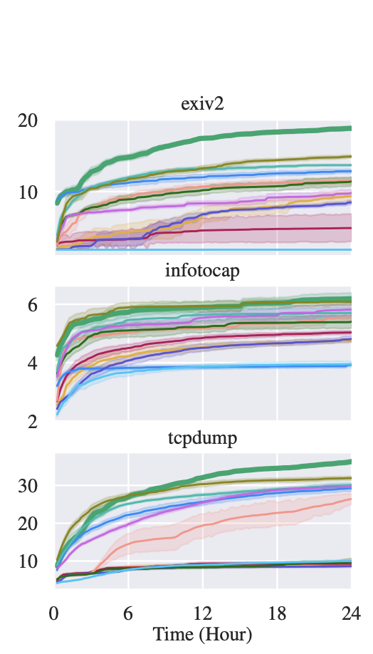
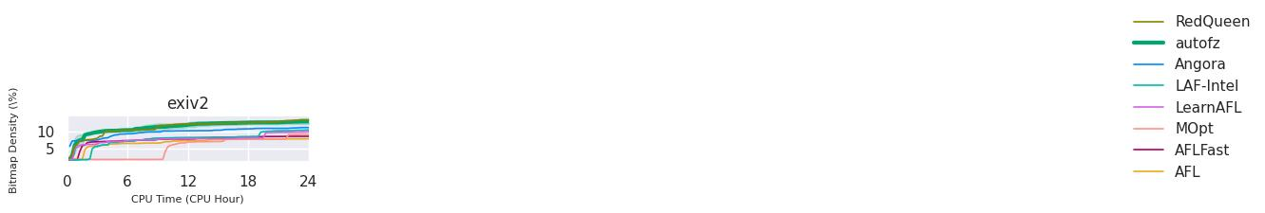
Recreating Autofz on AMD64
Recreate unmodified autofz environment with all baseline fuzzers and benchmarks
pre-built docker image
build script
Evaluate AMD64 autofz on four targets
exiv2
nm
mojs
tcpdump
Compare outcomes of presented AMD64 autofz and recreated AMD64 autofz

Slide 4
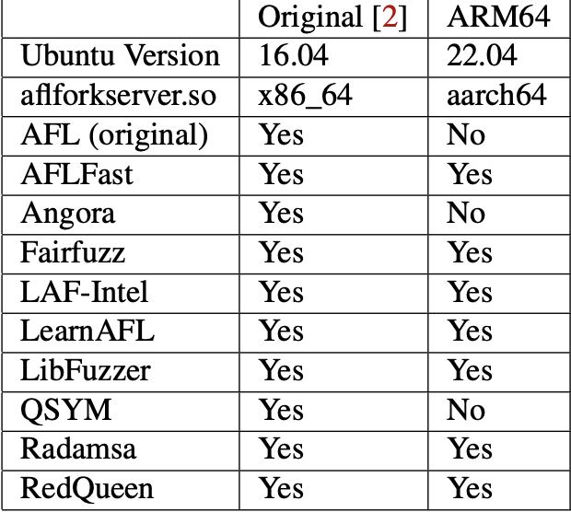
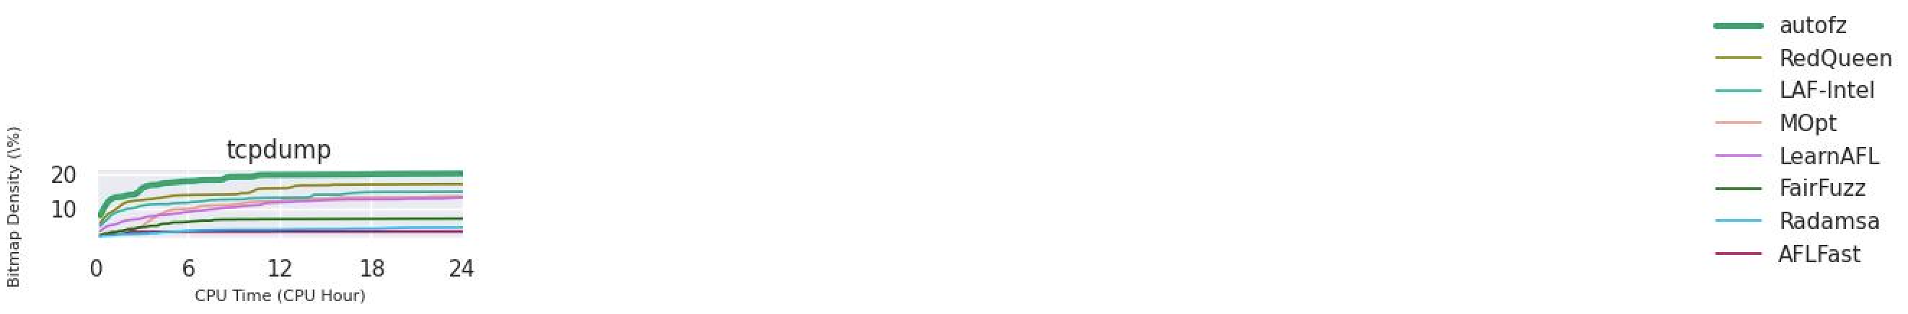
Creating Autofz on ARM64
Recreate modified autofz environment with all compatible fuzzers and benchmarks
Updated: Ubuntu 22.04
Excluded: Angora and QSYM
Evaluate ARM64 autofz on four targets
exiv2
nm
mojs
tcpdump
Compare outcomes of presented AMD64 autofz and ARM64 autofz

Slide 5
Implement Additional Metric for ARM64 Autofz
Problem: autofz relies on bitmap coverage metric to rank fuzzers and allocate resources
Bitmap coverage may not be the best metric for identify the best fuzzer for a target
Bitmap coverage indicates that an area of code was fuzzed, but it does not guarantee bug discovery
i.e., while a path may be fuzzed, it may not have been fuzzed with an input that will trigger a bug
Solution: reward fuzzers that discover more bugs during the preparation phase with more resources during the focus phase
Discovering more bugs across a smaller area of code decreases the attack surface by more entry points than discovering less bugs over a greater area of the code
Next Steps: implement and evaluate performance and efficiency of alternate metric

Slide 6
Contributions
Drew:
Recreated Autofz using docker image on AMD64
Tested AMD64 Autofz against two targets
Modified Autofz for ARM64
Tested ARM64 Autofz against two targets
Kate:
Recreated Autofz using build scripts on AMD64
Tested AMD64 Autofz against two targets
Tested ARM64 Autofz against two targets
Identified additional metric for Autofz

Slide 7
References
[1] Anonymous 2019. AFL (american fuzzy lop). https://afl-1.readthedocs.io/en/latest/index.html.
[2] Anonymous 2020. Apple unleashes M1 . https://www.apple.com/newsroom/2020/11/apple-unleashes-m1/.
[3] ECEIZA, M., FLORES, J.L. AND ITURBE, M. 2023. Improving fuzzing assessment methods through the analysis of metrics and experimental conditions. Computers & security 124, 102946. https://dx.doi.org/10.1016/j.cose.2022.102946.
[4] YU-FU, F., LEE, J. AND KIM, T. 2023. autofz: Automated Fuzzer Composition at Runtime. arXiv.org .

